Slide 1
Imibuzo evame ukubuzwa mayelana neringi yeDapivirine yesitho sowesifazane sangasese sangaphambili

Slide 2
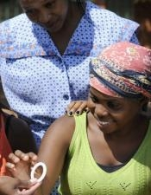
Kungani kube neringi yesitho sowesifazane sangasese sangaphambili yovikela igciwane lesandulela ngculazi?
Notes:
Ukunikeza izindlela zokuvikela igciwane lesandulela ngculazi kubalulekile ngoba owesifazane ngamunye angaba nezidingo ezahlukene.

Slide 3
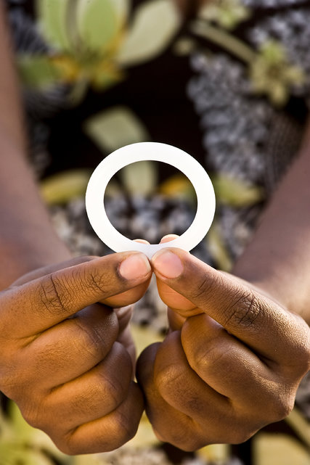
Isebenza isikhathi eside: Amaringi esitho sowesifazane sangasese sangaphambili ashuthekwa bese eshiywa ngaphakathi esithweni sangasese isikhathi esiyinyanga.
Amaringi esitho sowesifazane sangasese sangaphambili anganikeza izinzuzo eziningana
Notes:
Lokhu kungasiza abesifazane abathola kunzima ukukhumbula ukusebenzisa umkhiqizo nsuku zonke noma ngesikhathi benza ucansi.

Slide 4
Ubulula bokuyisebenzisa: Abasifazane abaningi bathola iringi kulula ukuyishutheka nokuyikhipha. Ukuphepha: Ucwaningo luveze ukuthi iringi iphephile ukuthi isetshenziswe. Ubumfihlo: Amaringi esitho sowesifazane sangasese sangaphambili angashuthekwa abuye akhishwe ngasese.
Amaringi esitho sowesifazane sangasese sangaphambili anganikeza izinzuzo eziningana
Notes:
Abanye besifazane bangakujabulela ubumfihlo uma bengafuni ukuthi abanye bazi ukuthi basebenzisa umkhiqizo wokuvikela iHIV.

Slide 5
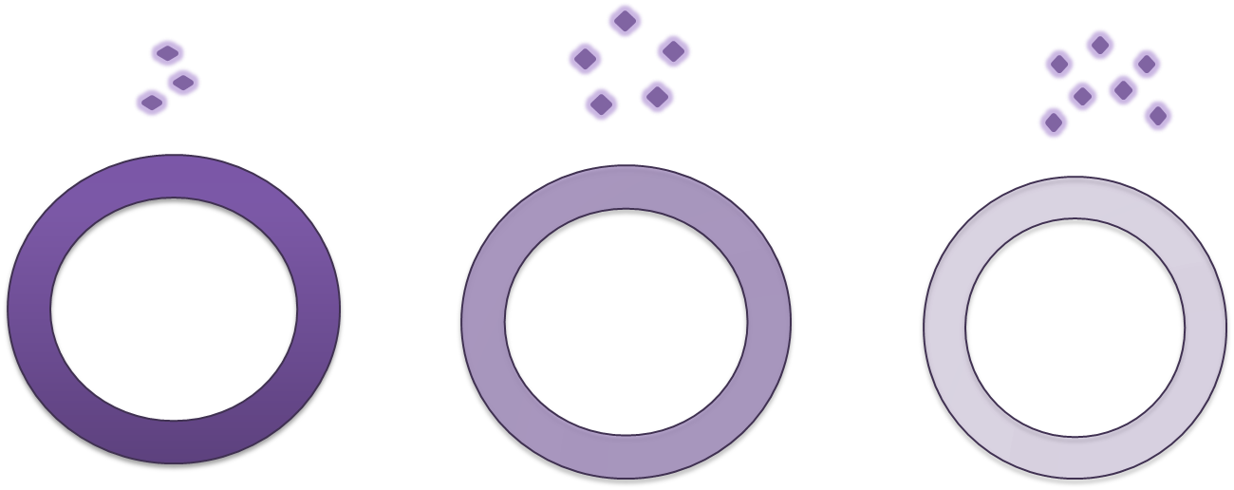
Isebenza kanjani iringi yedapivirine yesitho sowesifazane sangasese sangaphambili?
Uma iringi isesithweni sowesifazane sangasese sangaphambili, umshanguzo wedapivirine udedeleka kancane.

Slide 6
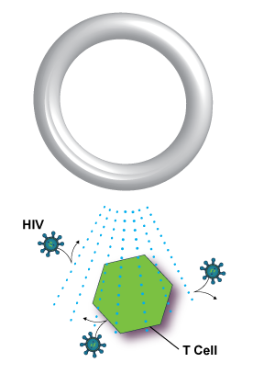
Isebenza kanjani iringi yedapivirine yesitho sowesifazane sangasese sangaphambili?
Idapivirine isebenza ngokuvimbela igciwane lesandulela ngculazi ukuba liziphindaphinde, ngalokhu uma owesifazane esengcupheni yegciwane lesandulela ngculazi ngesikhathi iringi yedapivirine isendaweni, igciwane lisemathubeni amaningi okufa ngaphambi kokusabalala emzimbeni wakhe.
Notes:
Ucwaningo luveze ukuthi iringi yedapivirine yesitho sowesifazane sangasese sangaphambili inganciphisa amathuba okutheleleka kowesifazane ngegciwane lesandulela ngculazi.

Slide 7
Isebenza kanjani iringi yedapivirine yesitho sowesifazane sangasese sangaphambili?
Uma isetshenziswa njalo, kubandakanya uma enza ucansi noma esesikhathini, ubungozi bokutheleleka bungaphansi kakhulu.

Slide 8
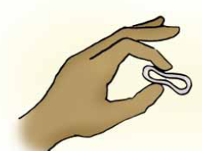
Ingabe kulukhuni ukuyishutheka noma ukuyikhipha iringi?
Abesifazane abaningi bathola iringi kulula ukuyishutheka nokuyikhipha.
Uma iringi ifakwa ngendlela, abesifazane abaningi abayizwa.
Notes:
Akukho ketshezi oludingekayo ukuyishutheka iringi, kodwa amanzi angasetshenziswa uma kunesidingo.

Slide 9
Ingabe iringi ingancibilika noma ilahleke ngaphakathi emzimbeni?
Cha. Iringi ngeke incibilike.
Iringi ngeke iphusheke iye phezulu kakhulu noma ilahleke emzimbeni ngaphakathi.
Notes:
Esikhathini esingangenyanga, umshanguzo wedapivirine uyadedeleka kancane kodwa iringi uqobo lwayo ayiguquki.

Slide 10
Ingabe iringi izophuma?
Lokhu akuvamisile, kodwa kungenzeka.
Uma abesifazane bekhathazekile ukuthi iringi isiphumile, bangasebenzisa njalo umunwe wabo ukubheka ukuthi isashuthekiwe yini noma ukuyibeka ngendlela iringi.
Uma iringi iqathaka, ingayakazwa ngamanzi ahlanzekile bese iyashuthekwa futhi.

Slide 11
Ingabe ikhona imithelela emibi ngokusebenzisa iringi?
Ucwaningo luveze ukuthi iringi enedapivirine yesitho sowesifazane sangasese sangaphambili iphephile ukushiywa ishuthekiwe isikhathi esingangenyanga ngayinye.
Ayiwuguquli ubungako noma ukuma kwesitho sowesifazane sangasese sangaphambili, ibange umdlavuza wesibeletho, noma iholele kwezinye izinkinga zezempilo ezibalulekile.
Iringi ayiyiphazamisi indlela yokuya esikhathini yowesifazane.

Slide 12
Ingabe abesifazane noma omaqondana babo bazoyizwa iringi ngesikhathi benza ucansi?
Abanye besifazane nomaqondana babo bangayizwa iringi esithweni sangasese sowesifazane sangaphambili ngesikhathi benza ucansi, kodwa lokhu ngeke kwalimaza noyedwa kubona.
Abasifazane bayagqugquzelwa ukuthi baxoxe ngokusebenzisa iringi nomaqondana babo.

Slide 13
Ingabe abesifazane noma omaqondana babo bazoyizwa iringi ngesikhathi benza ucansi?
Ukushiya iringi ishuthekiwe ngezikhathi zonke, kubandakanya ngesikhathi sokwenza ucansi, kunikeza ukuvikeleka okukhulu kwigciwane lesandulela ngculazi.

Slide 14
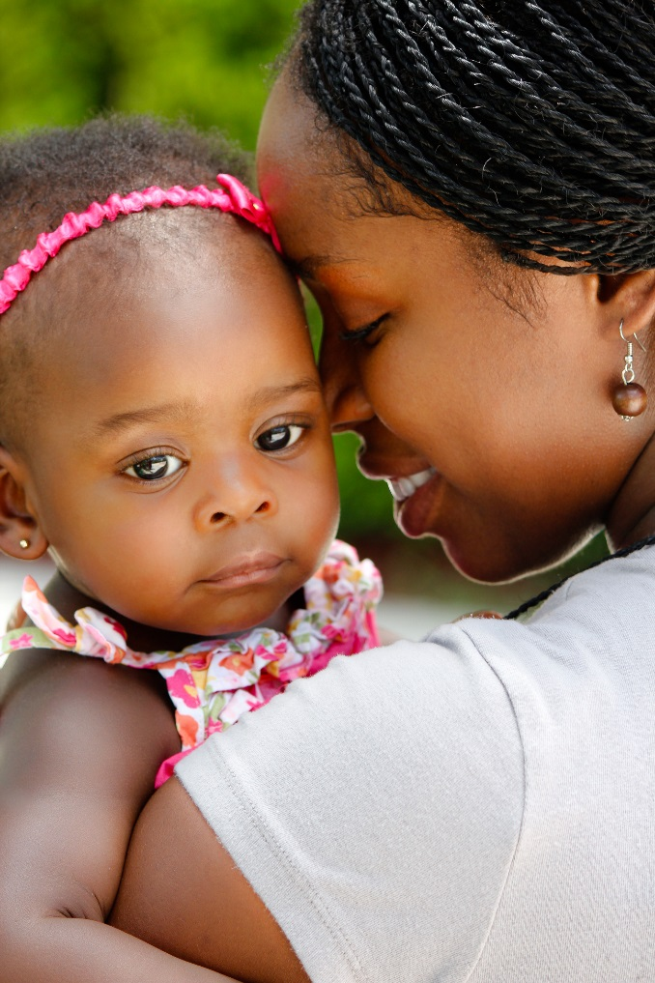
Kwenzekani uma abesifazane bekhulelwa iringi ibe ishuthekiwe? Ngabe kuzoyilimaza ingane?
Abacwaningi abakazi ukuthi idapivirine ingaba nomthelela onjani enganeni yowesifazane uma esebenzisa iringi ngesikhathi ekhulelwe. Ngenxa yalokhu, abesifazane bayacelwa ukuba basebenzise okokuvikela ukukhulelwa ngesikhathi besebenzisa iringi, futhi bayeke ukusebenzisa iringi uma bekhulelwe.
Notes:
Kusahlelwa ucwaningo oluzobheka ukuthi kungabe kuphephile yini ukusebenzisa iringi uma ukhulelwe.

Slide 15
Ingabe kukhona abesifazane okumele bakugweme ngesikhathi besebenzisa iringi?
Nakuba usebenzisa iringi, izindlela ezihlanzekile zokunakekela isitho sangasese sowesifazane sangaphambili bayazikhuthaza abasebenzi baseklinikhi.

Slide 16
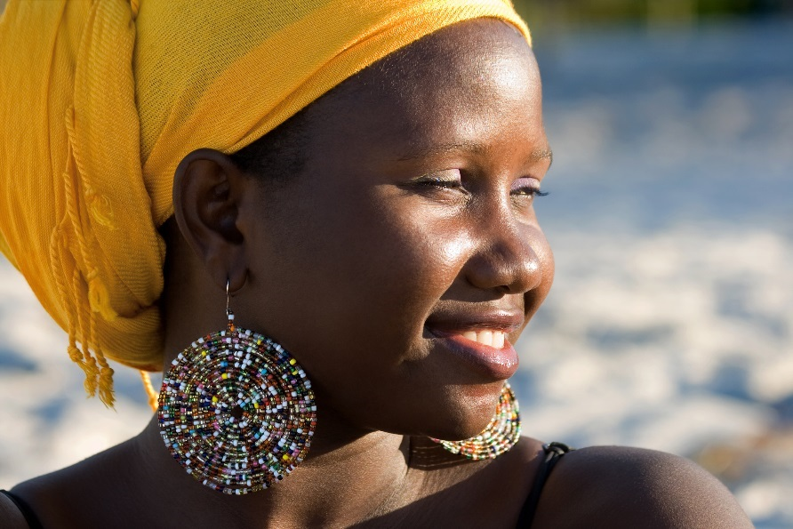
Ingabe kukhona abesifazane okumele bakugweme ngesikhathi besebenzisa iringi?
Abesifazane akufanele basebenzise izigezo, izinsipho, noma ezinye izikhucululi ukuhlanza ingaphakathi lesitho sowesifazane sangasese sangaphambili. Abesifazane akufanele basebenzise amakhambi noma ezinye izinto ukomisa noma ukunciphisa isitho sangasese sowesifazane sangaphambili.
Notes:
Lezikhucululo zinobungozi futhi zinganyusa amathuba ezifo zesitho sangasese sangaphambili sowesifazane.

Slide 17
Ingabe kukhona abesifazane okumele bakugweme ngesikhathi besebenzisa iringi?
Ngesikhathi usebenzisa iringi, ukusetshenziswa kwama diaphragms, nezinkomishi zokuya esikhathini kanye nezivimbo zesibeletho akugqugquzelwa kanye nokusetshenziswa kwamaringi esitho sowesifazane sangasese sangaphambili avimbela ukukhulelwa akuvumelekile.

Slide 18
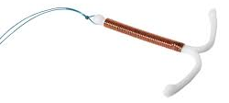
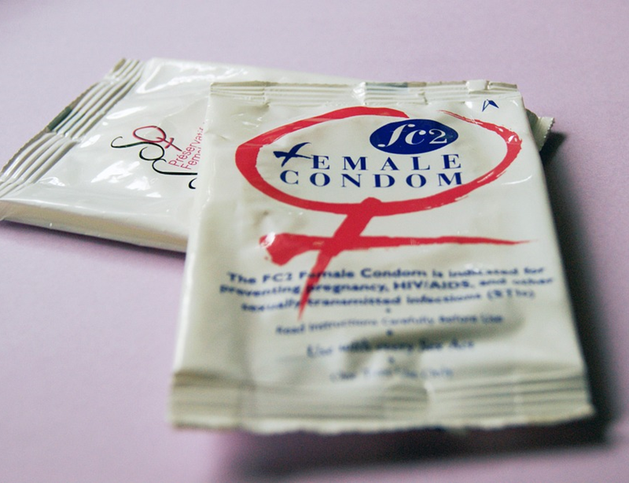
Ingabe kukhona abesifazane okumele bakugweme ngesikhathi besebenzisa iringi?
Abesifazane bangasebenzisa amathemponi, amakhondomu abesilisa nabesifazane, izibulali sidoda, izithambisi, iIUCD (iluphu), neminye imishanguzo yodokotela yesitho sowesifazane sangasese sangaphambili noma izinsiza abaziyalelwe udokotela.

Slide 19
Uma unemibuzo noma udinga ulwazi olwengeziwe, sicela uvakashele eklinikhi yocwaningo.

